Slide 1
Supervised Learning project
Wendy Navarrete October 2019
Notes:
Hello everybody, welcome to this presentation. Let me introduce myself, my name is Wendy Navarrete, I am Software engineer. I started this program on May this year, since that I’ve learned a lot of things and today is my opportunity to present my supervised learning project

Slide 2
CONTENT
Introduction
Information of Data
Attributes
Business Question
The Process
Results
Practical Uses
Opportunities to improve
Q&A
Notes:
This is the content that I am going to present today. I’ll begin with a brief introduction of this project, I’ll present the data that data and its attributes.Very important to mention what the business question I want to answer with project. And also I will talk about the process, the results and some practical uses of this model. At the end, it will be some time for Q&A

Slide 3
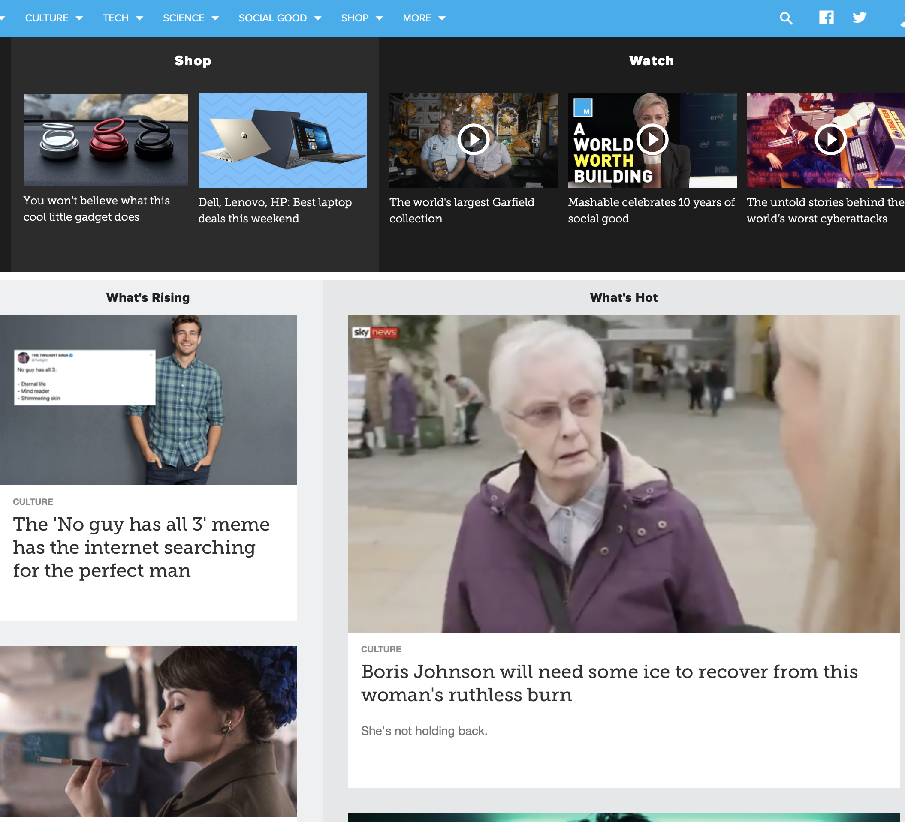
Introduction
This document contains the development and findings of a Data Science Project, which objective is to predict the popularity of articles published by Mashable website.
Notes:
What is this project about?
Obviously this is a Data Science project, I will present you the development and findings that I get. Basically the goal of this project
is to predict the popularity of articles published by a website.

Slide 4
Information of data
This dataset summarizes a set of features about articles published by Mashable in a period of two years. The goal is to predict the popularity.
It came from UCI Machine Learning Repository website
It was obtained by downloading a csv file from website mentioned above
Dataset description
Number of Attributes | Attributes Characteristics | Number of Instances | Missing Values? | Outliers?
61 | Numeric and text | 39797 | No | Many
Notes:
This dataset contains a set of features about articles posted by Mashable website during 2 years. As I told you the goal is to predict the popularity of those articles based on how many time people share those articles
- This data is public, is from UCI Machine Learning repository
I got it by downloading csv file
And it has 61 attributes, those are basically text and numbers
It has 39 thousand and7 hundred 97 instances
Something particular of this dataset is that It has no missing values but it has a lot of outliers

Slide 5
Attributes
WORDS: Number of words in title and content
LINKS: Number of links
INFORMATIVE: URL
TIME: Posting days (weekdays and weekend)
KEYWORDS: Best, worst, average keywords
MEDIA: Number of images and videos
LANGUAGE: Content and title sentiment polarity; positive or negative words in content
Notes:
Let’s talk about the attributes of the dataset, here you can see the categories that I created. I did it because was easier for me to handle, to analyze and understand the 69 attributes into the dataset.
Basically those are the characteristics of articles or publications. This way there are some categories like words, keywords, media etc

Slide 6
ATTRIBUTE DETAILS
Attribute | Type (#)
WORDS
Number of words in the title and content | numeric (2)
Average word length | numeric (1)
Rate of unique, non-stop and unique non-stop word | ratio (3)
Average length of the words in the content | numeric (1)
LINKS
Number of links | numeric (1)
Minimum, maximum and average of shares of referenced articles in Mashable | numeric (3)
Number of links to other articles published by Mashable | numeric (1)
Attribute | Type (#)
KEYWORDS
Average, worst and best keywords (min, max and avg.) | numeric (9)
Number of keywords | numeric (1)
Channel category (Lifestyle, entertainment, business, tech, social media and word) | boolean (6)
MEDIA
Number of videos and images | numeric (2)
INFORMATIVE
Article URL | string (1)
Days between the article publication and the dataset acquisition | numeric (1)
Notes:
I don’t want to talk about the 69 attributes, I just want to give an idea about them. You can see here more detail about the attributes and the type of the attributes, we have numeric, boolean, string or ratio.
For instance, how many images and videos the article contains, what the url is to reference the article; for instance keyword, the channel category, if you go to mashable website you can see channels like business, entertainment, tech, social etc.

Slide 7
ATTRIBUTE DETAILS
Attribute | Type (#)
LANGUAGE PROCESSING
Content subjectivity and sentimental polarity | ratio (2)
Rate of positive and negative words in the content | ratio (2)
Rate of positive words among non-neutral tokens | ratio (2)
Polarity of positive and negative words (min, max and avg.) | ratio (6)
Title subjectivity and sentimental polarity | ratio (2)
Title subjectivity and polarity absolute levels | ratio (2)
Closeness to LDA topics (0-5) | ratio (5)
TIME
Posting day (Monday to Sunday and Weekends) | boolean (8)
Attribute | Type (#)
TARGET
Number of article shares | numeric (1)
Notes:
This is the last slide with attributes and the most important here is the TARGET. My target is how many times an article is shared. Let’s go to the next slide

Slide 8
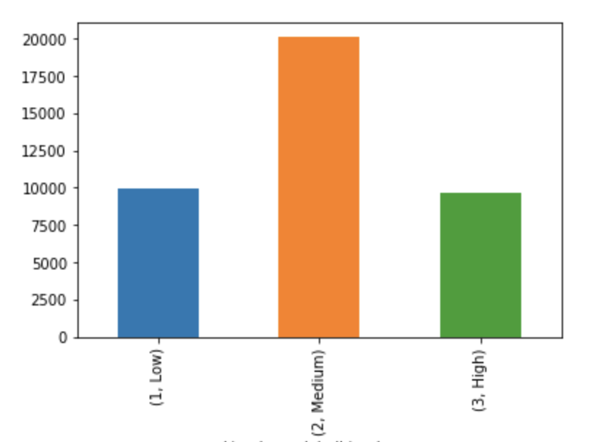
How popular is an article published by Mashable website?
Low
Medium
High
Notes:
This is the business question that this project is trying to answer: how popular is an article published on mashable website.
based on how many times an article is shared

Slide 9
The Process
Data Extraction
Data Cleaning
Missing Values
Outliers
Data Exploration
Target Classification
Feature Engineering
Modeling
Feature Selection
Class Balance
Model Selection
Evaluate Predictions
Model Tuning
Notes:
Here is the process I follow, it’s true is sequential process but it is also an iterative process. Main steps into the process were data extraction….until modeling
Data extraction was to easy
Data cleaning
Comment about outliers, 39 columns to be handled
Log transformation
Winsorize one and two ways

Slide 10
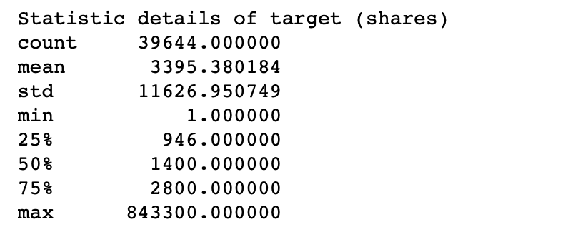
The Process
Data Exploration
Target Classification
Notes:
Originally my target was a numeric target.
Analyzing my target, I can say that the minimun value is 1, it means all publications were shared at least once. In average articles are shared 3 thousands 4 hundred around
Based on my target’s quantiles I created 3 classes, let me explain:
Low : 0 to 946
Medium: from 947 to 2800 (it represents the 50% of my target)
High : greater than 843300 is into high class

Slide 11
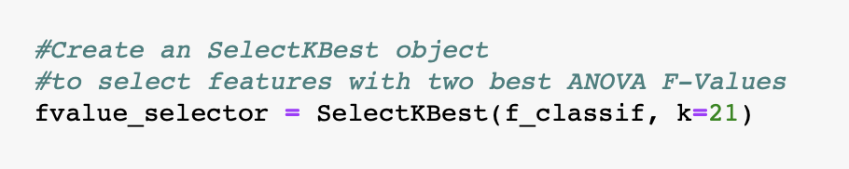
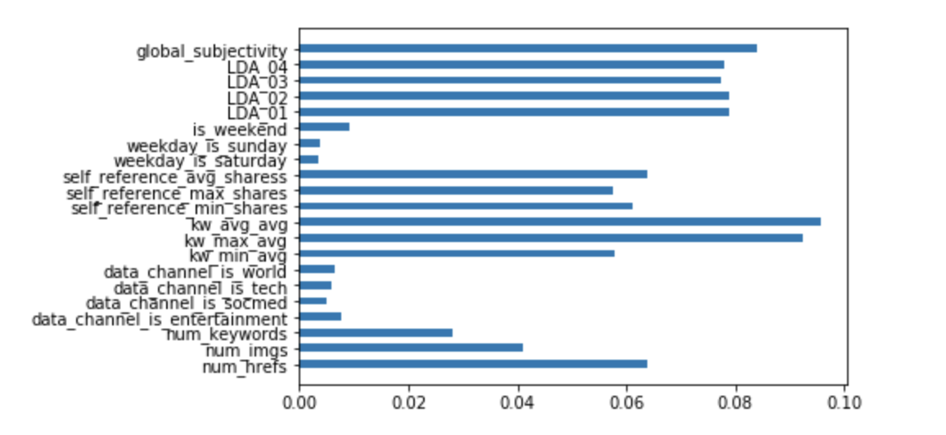
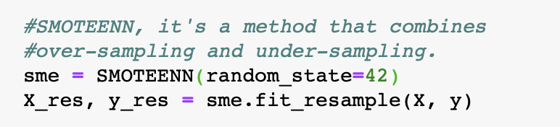
The Process
Feature Engineering
Feature Selection
Class Balance
SelectKBest Technique for Feature Selection
Check feature importance using Random Forest
Notes:
At this time of the process I’ve already done with data extraction, cleaning and exploration so, next step was feature engineering. for feature selection I decided to use
SelectKbest Technique helped to choose the best predictors for the target variable. It uses a function to score the features (So its kind of a wrapper)
Improves Accuracy: Less misleading data means modeling accuracy improves.
Reduces Training Time: Less data means that algorithms train faster.
The other technique I used was feature importance, and the end I keep 16 features.
----------------------
Last step was Class Balance. the technique I used for balancing my target was SMOTEEEN, it combined over-sampling and undersampling methods
Receive a score function and the number of features we want to keep.
Feature selection method: SelectKBest
Score function: For regression: f_regression, mutual_info_regression For classification: chi2, f_classif, mutual_info_classif

Slide 12
The Process
Classification Models:
Random Forest
Support Vector Classification
KNN / K-Nearest Neighbor
Evaluate predictions:
Training accuracy score vs Test accuracy score
Model Tuning:
Grid Search
Modeling
Model Selection
Evaluate Predictions
Model Tuning
Notes:
Last step in the process, was Modeling. Where I choose 3 classification models. I evaluate predictions and Also tune the models to get the best results

Slide 13
results
Model | Training Set Accuracy Score | Test Set Accuracy Score
Random Forest | 1.0000 | 0.80470
SVC | 1.0000 | 0.62370
KNN | 0.8261 | 0.75512
Overall, the best result was achieved by a K-nearest neighbor (KNN), with a 75.51% of accuracy on predictions
Notes:
Those are my results, as you can see the first 2 models were overfitting, even when I applied some regularization techniques was hard to eliminate overfitting. So the best results was achieved by K-nearest neighbor with 75% of predictions

Slide 14
practical uses
Because this model objective is to predict the level of popularity of articles based on number of shares, this model can be applied basically in most of the websites which interest to share their own content
Some examples:
Blogs sites
Newspaper sites
Magazine sites
Notes:
Practical uses, since the goal of this model is to predict the popularity of publications based on the numbers of shares, this model can be applied to blog sites, newspaper, or magazines websites

Slide 15

Opportunities to improve
This model was compared with just two other models
Two of those models presented overfitting. After applied different techniques of regularization, overfitting is still there
Because the range of numbers of shares is very large, the target bins might result in more than three classes and get more precise results
Notes:
As everything, this model has the opportunity to be improved. One of the shortcomings is that the model was compared with two models
- Those models were overfitting
- Other thing to improve is having more than 3 classes in my target. The range of number of shares is very large, so target bins might results in more than 3 classes, maybe 5 to get more accurate results

Slide 16
Q & A
Notes:
That’s all I have, it’s time for Q&A

Slide 17
THANKS
Wendy Navarrete
navarrete.wen@gmail.com
Notes:
Thanks for your attention and your time.

